Slide 1
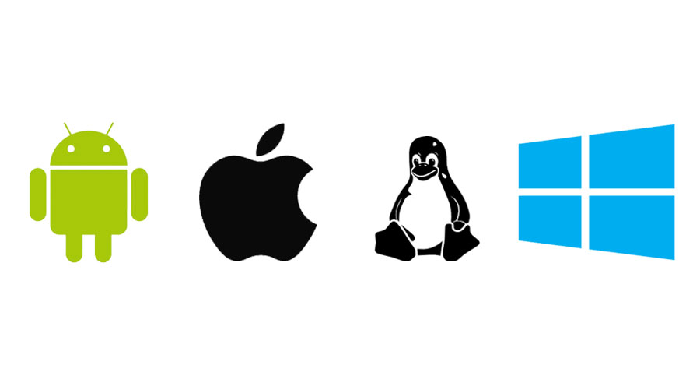
Operating System

Slide 2

Contents
Operating system
Function of OS
Example of computing device which use OS
Operations of OS
Features of operating system
Types of operating system
Stand alone operating system
Advantages and disadvantages of WINDOWS
Advantages and disadvantages of mac OS
Advantages & disadvantages of LINUX
Server operating system
Server needs
Mobile operating system

Slide 3
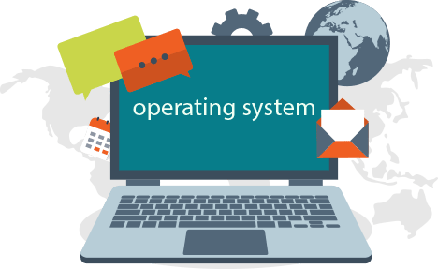
Operating System
It performs basic tasks, such as:
Recognizing input from the keyboard or mouse.
Sending output to the monitor.
Keeping track of files and directories on the disk.
Controlling peripheral devices such as disk drives and printers.

Slide 4

Functions of OS
Providing a user interface
Running applications
Support for build in utility programs
Control the computer hardware

Slide 5



Example of computing devices which use OS
Computers
Mobile phones
Video games
ATM

Slide 6
Operations of OS
Start and shut down a computer | Provide a user interface | Manage programs
Coordinate tasks | Configure device | Manage memory
Establish an internet connection | Control a network | Provide utilities

Slide 7
Features of operating system
Operating system
GUI | Multi user | Multi tasking | Multi processing | Multi threading

Slide 8
Types of operating system
Stand alone operating system.
Server operating system.
Embedded operating system.

Slide 9
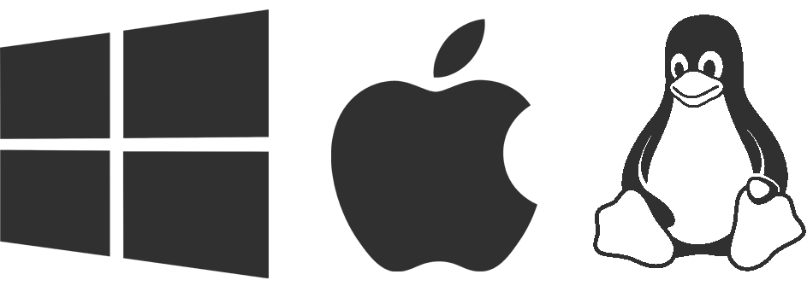
Stand alone operating system/Desktop operating system
Stand alone operating system

Slide 10
Advantages and disadvantages of windows
expensive
Easy to use
update
advantages
disadvantages
Gaming
famillar
Not secure
Not stable

Slide 11
Advantages and disadvantages of mac OS
Great GUI
Not gaming
advantages
disadvantages
stable
secure
Not all software run
expensive
Better to graphic designer

Slide 12
Advantages & disadvantages of LINUX
Poor Support for gamer
Low pc requirement
disadvantages
advantages
free
secure
Not all software run
Hard to learn ,use & install

Slide 13
Server operating system
Server operating systems are designed to provide platforms for multi-users, for critical , network applications.
There main purpose is to provide security , stability and collaboration. Most of them come with a pack of dedicated software tools such as Web server , e-mail agents and terminal services. The common applications for server OSes are :
File and printer sharing
Application services (including databases)
Web site services
E-mail, groupware and messaging
Terminal services
Caching

Slide 14
Server needs
ADMINISTRATION
SERVER NEEDS
SECURITY
STABILITY

Slide 15
Mobile operating system
Mobile OS
Symbian OS | iphone OS | RIM BlackBerry | Windows Mobile | Linux | Palm OS

Slide 16
Summary
Best operating system
Rank | Solution | Type | Score | Price
1. | Windows 10 | software | 92 | Free
2. | Apple OS | software | 91 | Free
3. | Windows 7 | software | 87 | Free
4. | Ubuntu | software | 83 | Free
5. | Android | software | 83 | Free
6. | Apple OS X EL Capitan | software | 80 | Free

Slide 17


